Slide 1
Analytics Project..
Hello everyone, I am Resham Shaw from DANLC WBBTI ANP-C8484 batch , Student ID: AF0439383 and my today’s Project is on the topic provided by my instructor Mrs. Khusbu Thakur Ma’am & I am Thankful to Madam for giving me this opportunity to do this project successfully..
Let’s start with project’s topic and its content..

Slide 2
Problem Statement:
Nitin works as a Graphic Designer in a new company. He earns Rs 15,000/- per month. He is planning to buy a scooter for his daily commute to the office.
For the last couple of months , Nitin is not able to save at all for his scooter. His friend Ayush told him that he needed to figure out where most of the money goes and cut down that expense.
Help Nitin increase his savings by removing some unnecessary expenses.

Slide 3
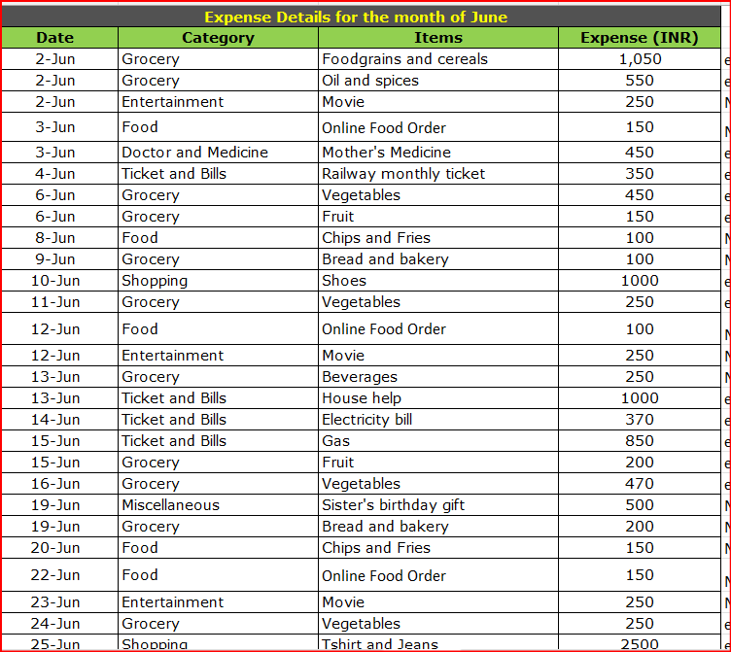
Nitin’s June month overall expenses details..

Slide 4
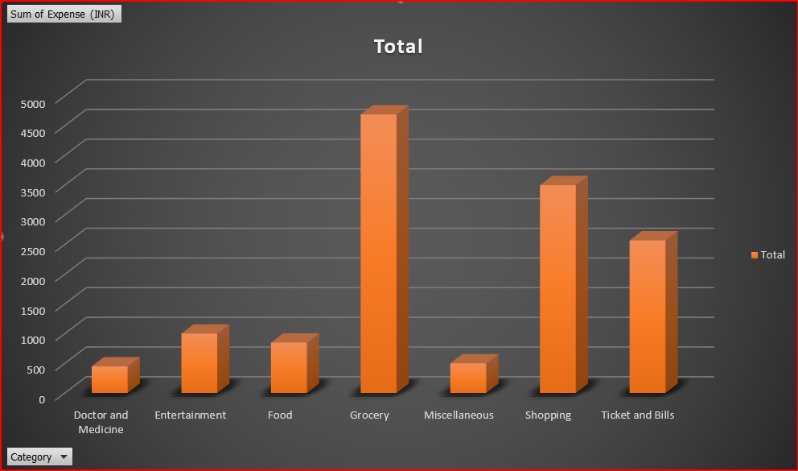
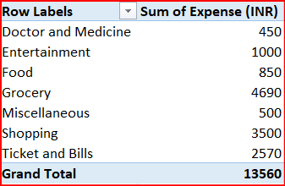
Nitin’s June month highest expense chart:

Slide 5
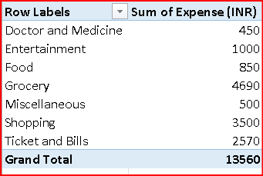
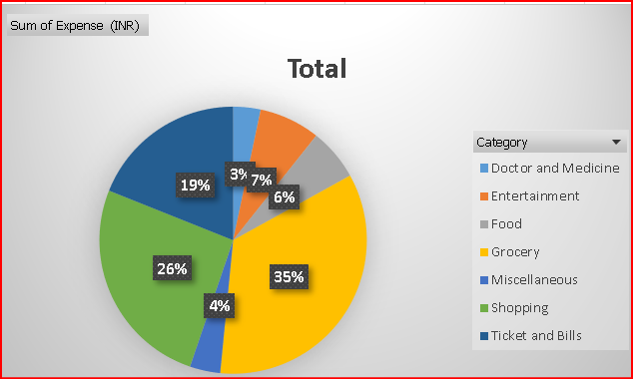
The visual representation of the amount spent against each category in June month in percentage of the total expense amount in the pie chart..
Nitin’s spent for each category in June month is shown in a pivot table..

Slide 6
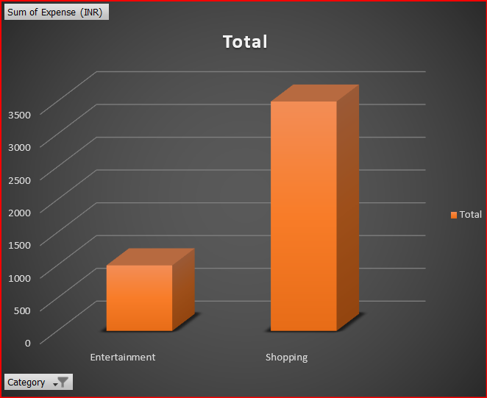
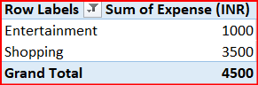
Nitin’s total expense amount against Entertainment & Shopping in June month:

Slide 7
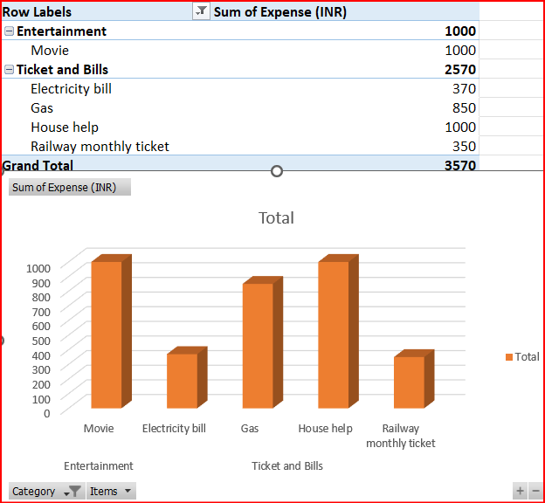
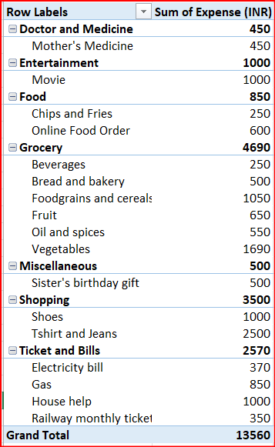
Nitin’s spent in June month on different items of each category in pivot table.
The visual representation of Nitin’s amount in June month spent on different items of Entertainment & Tickets & bills category in the column chart..

Slide 8
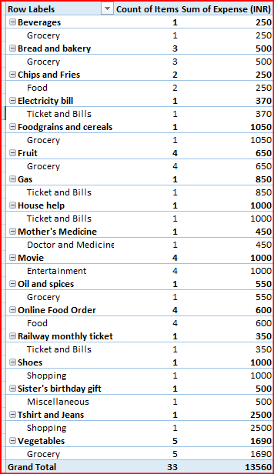
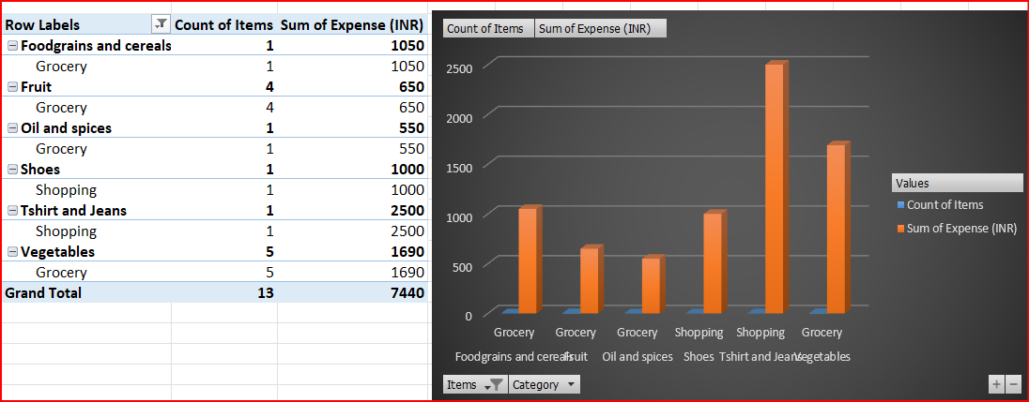
Nitin’s number of times money spent against different items of each category in June month given in a pivot table & the filtered data that display data for Grocery & Shopping items..

Slide 9
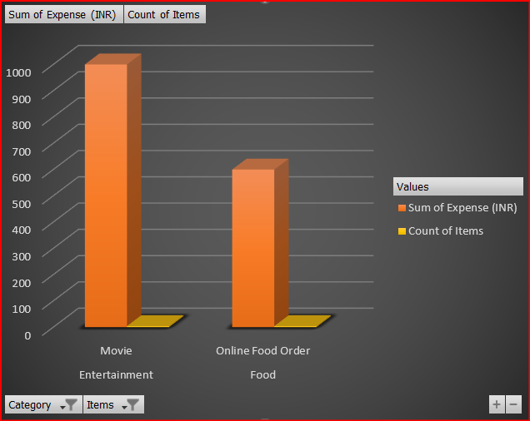
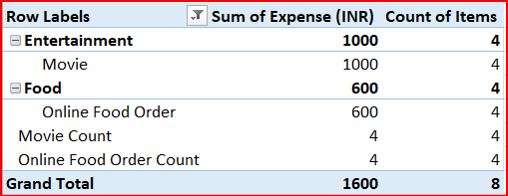
Number of times Nitin has ordered food online & watched movie along with the amount spent for both of it in the month of June:

Slide 10
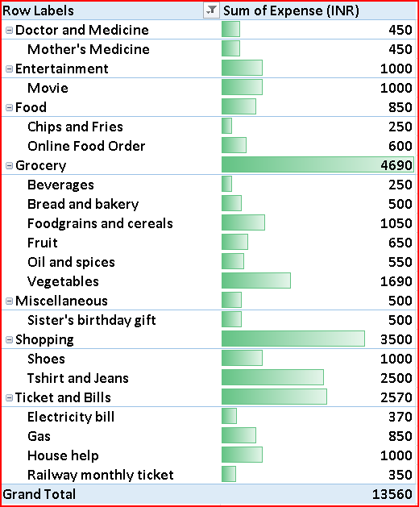
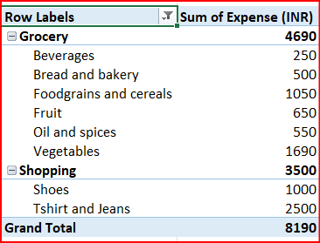
Nitin’s amount spent in June month on each item of categories with highest & 2nd highest expense amount in a pivot table.
The visual representation of data with data bars (Conditional formatting)..

Slide 11
The less essential category that Nitin may remove to increase his savings are: To help Nitin increase his savings for a scooter, he should evaluate his monthly expenses and identify areas where he can cut back. Here's a breakdown of potential non-essential categories he might consider reducing: Online Food Orders: Instead of ordering food online, Nitin could cook at home. This could save a significant amount since delivery fees and restaurant markups can add up quickly. Movies and Entertainment: Nitin could limit his outings to movies or switch to more affordable forms of entertainment, like watching movies at home or using streaming services he already subscribes to. Chips and Fries: Snacks like chips and fries are often high in cost and low in nutrition. He could opt for healthier and cheaper alternatives like fruits, nuts, or homemade snacks. Beverages: If he frequently buys beverages like sodas or coffee, he could switch to making these at home or drinking water. This can lead to substantial savings over time. Bakery Items: If he buys bread and pastries regularly, he might consider making his own bread or buying in bulk to save money. Suggested Budget Cuts Here’s a simplified approach Nitin could take: Online Food Orders: Reduce frequency from multiple times a week to once a month. Movies: Instead of going out, plan a movie night at home once a month. Snacks: Cut down on buying chips and fries and replace them with healthier snacks. Beverages: Limit spending on drinks by opting for homemade options. Bakery: Purchase bulk bread or bake at home.

Slide 12
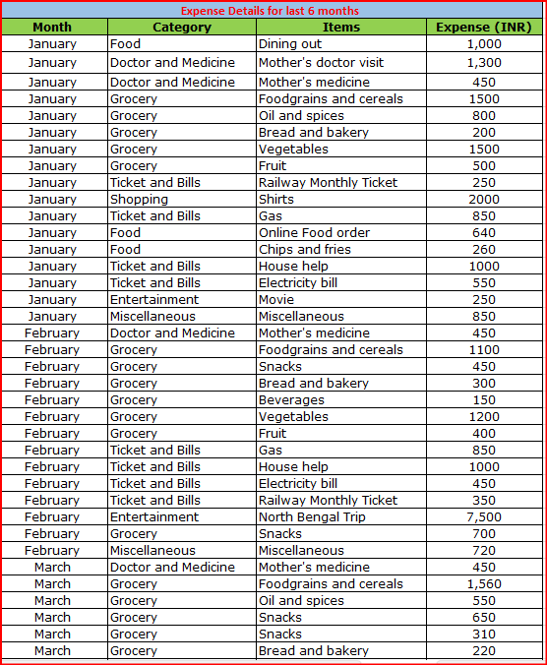
Nitin’s 6 months overall expenses details..

Slide 13
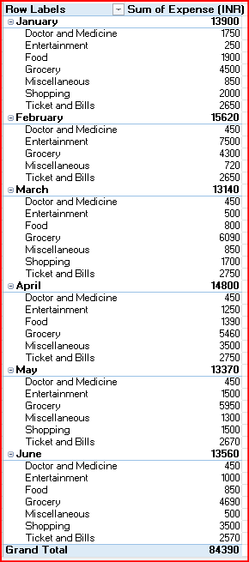
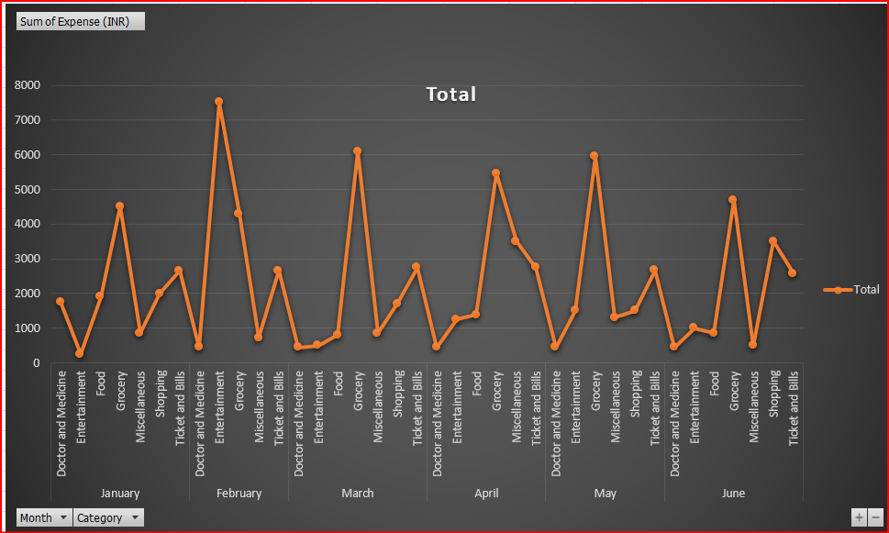
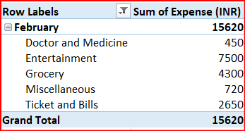
Nitin’s month-wise trend of expenses during 6 months is shown in the Pivot table & chart.. The month Nitin spent the most is February in the duration of 6 months..

Slide 14
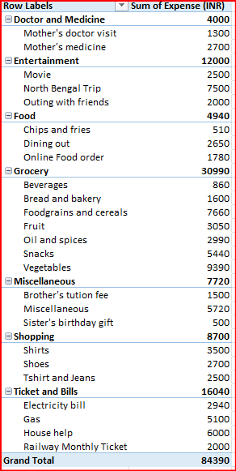
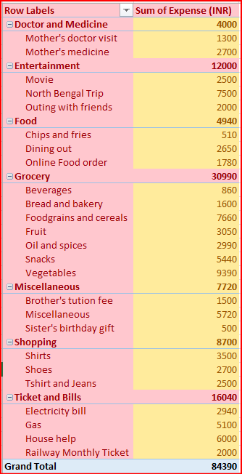
Nitin’s category wise expenses of the 6 months in pivot table..
The visual representation of data bars to display categories with the highest & lowest expense amount made by Nitin for the 6 months..

Slide 15
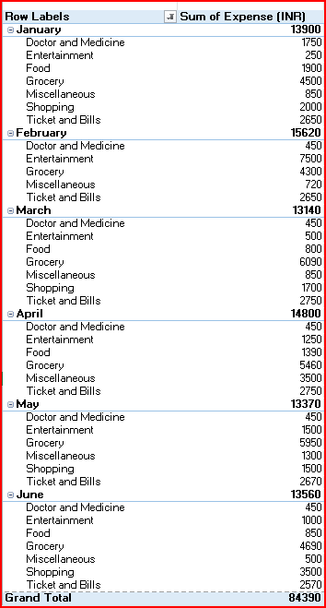
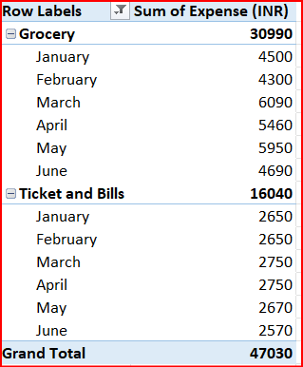
Nitin’s month-wise expense of each category for 6 months in pivot table..
The 2 categories with higher expenses made by Nitin for each of the 6 months are..

Slide 16
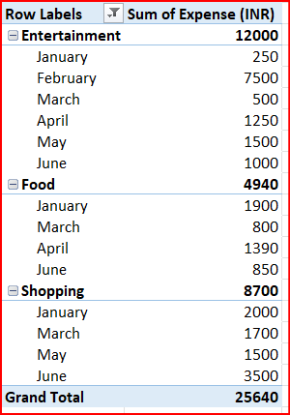
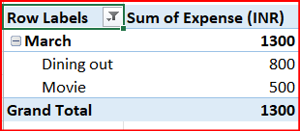
Nitin’s money spent in each month against different items of Entertainment, Food & Shopping categories for 6 months in Pivot table..
Total months that have the highest amount spent for movies & dining out made by Nitin is in March in duration of 6 months..

Slide 17
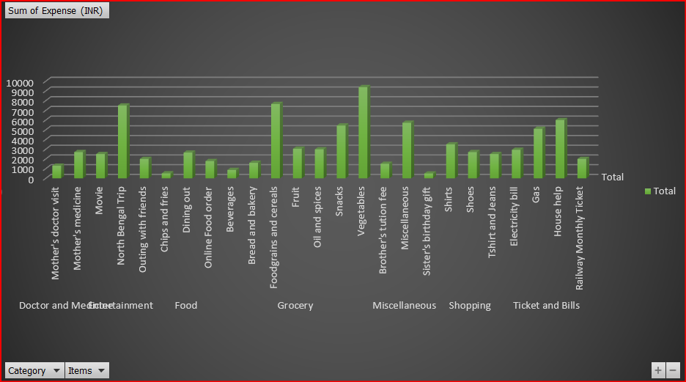
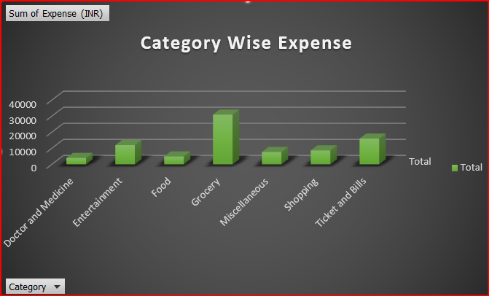
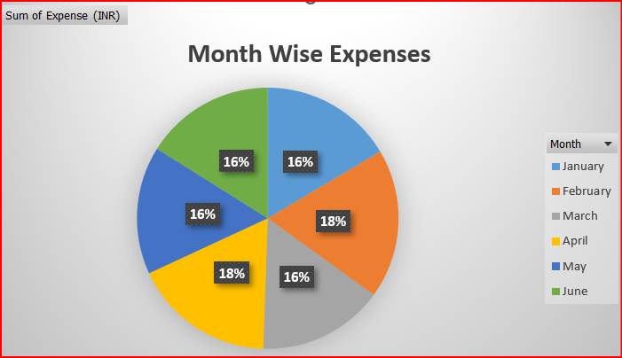
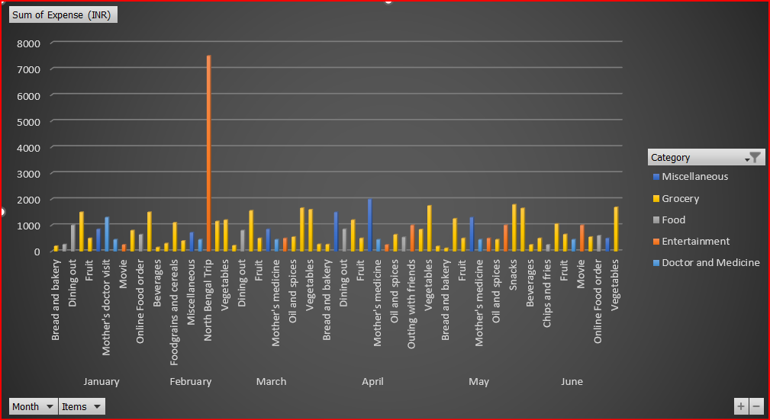
Analysis on the Nitin’s 6 months expenses on essential & non-essential items..

Slide 18
Recommendations to Nitin how he can increase his savings by some methods like:
1. Reduce Shopping experiences: Nitin spends an average of Rs 1,500 per month on shopping. He can reduce that by avoiding impulsive purchasing and buying only what is necessary.
2. Control of miscellaneous expenses: Nitin’s miscellaneous expenses are high, averaging Rs 1200 per month. He can reduce that by avoiding impulsive purchases and tracking his expenses.
3. Use the 50/10/20 rule: Allocate 50% of income towards necessary expenses, 10% towards discretionary spending, and 20% towards saving and debt repayment.

Slide 19
THANK YOU!

